Slide 1
Writing Corner #2
Punctuation: Commas

Slide 2
What are commas?
Commas (,) are punctuation marks that separate words and word groups to help readers understand a sentence.
Commas are used
to separate three or more items in a series:
I am wearing a hat, gloves, and a scarf.

Slide 3
to separate a compound sentence: two sentences joined by and, but, for, nor, or, so, or yet :
I am tired every morning, but coffee wakes me up.
to set off introductory words:
Unfortunately, I won’t be able to make to class tonight.
If I am correct, it will take twenty five hours to drive to the Grand Canyon.

Slide 4
to set off appositives:
An appositive is a phrase that renames a noun.
Betsey DeVos, the new Secretary of Education, will speak at the meeting.
[The underlined words rename Betsey DeVos.]

Slide 5
to set off adjective clauses that can be taken out of a sentence without completely changing the meaning.
Adjective clauses begin with who, which, or that.
Alicia, who used to live in that house, moved to New Jersey.
Do not use commas to set off adjective clauses essential to the meaning of a sentence.
Children who see their parents read are more likely to want to read themselves.

Slide 6
to set off quoted words from the rest of a sentence:
“I know what the thief looked like,” the victim said.
The police officer replied, “Please tell me.”
to separate the parts of an address:
They live at 701 S Gregory St, Urbana, Il 61801.
to set off the name of someone addressed directly:
Tom, can you please come here?

Slide 7
to set off yes or no when these words are a response to a question:
Yes, I like apple pie.
No, I don’t like mushrooms.

Slide 8
Ready for a quiz??
Feel free to reference the handouts or any notes to help you

Slide 9
1. Choose the sentence that has no comma errors.
A) Pete, when you go to the store, please buy carrots, tea, and coffee filters.
B) Pete, when you go to the store, please buy carrots, tea and coffee filters.
C) Pete when you go to the store, please buy carrots, tea, and coffee filters.
D) none of the above

Slide 10
1. Choose the sentence that has no comma errors.
ANSWER:
A) Pete, when you go to the store, please buy carrots, tea, and coffee filters.
B) Pete, when you go to the store, please buy carrots, tea and coffee filters.
C) Pete when you go to the store, please buy carrots, tea, and coffee filters.
D) none of the above

Slide 11
2. Choose the sentence that has no comma errors.
A) After school, Ann, an old friend, drove me home.
B) After school Ann, an old friend, drove me home.
C) After school, Ann an old friend drove me home.
D) none of the above

Slide 12
2. Choose the sentence that has no comma errors.
ANSWER:
A) After school, Ann, an old friend, drove me home.
B) After school Ann, an old friend, drove me home.
C) After school, Ann an old friend drove me home.
D) none of the above

Slide 13
3. Choose the sentence that has no comma errors.
A) I asked Bob if he would baby sit, but he frowned and said, “I’m busy that night.”
B) I asked Bob if he would baby sit but he frowned and said “I’m busy that night.”
C) I asked Bob, if he would baby sit, but he frowned, and said “I’m busy that night.”
D) none of the above

Slide 14
3. Choose the sentence that has no comma errors.
ANSWER:
A) I asked Bob if he would baby sit, but he frowned and said, “I’m busy that night.”
B) I asked Bob if he would baby sit but he frowned and said “I’m busy that night.”
C) I asked Bob, if he would baby sit, but he frowned, and said “I’m busy that night.”
D) none of the above

Slide 15
4. Choose the sentence that has no comma errors.
A) My birthday is September 25 1968 which is the same as Will Smith’s.
B) My birthday is September 25 1968, which is the same as Will Smith’s.
C) My birthday is September 25, 1968, which is the same as Will Smith’s.
D) none of the above

Slide 16
4. Choose the sentence that has no comma errors.
ANSWER:
A) My birthday is September 25 1968 which is the same as Will Smith’s.
B) My birthday is September 25 1968, which is the same as Will Smith’s.
C) My birthday is September 25, 1968, which is the same as Will Smith’s.
D) none of the above

Slide 17
5. Choose the sentence that has no comma errors.
A) According to Steve an expert on the North Pole there is no Santa Claus.
B) According to Steve, an expert on the North Pole, there is no Santa Claus.
C) According to Steve, an expert on the North Pole there is no Santa Claus.
D) none of the above

Slide 18
5. Choose the sentence that has no comma errors.
ANSWER:
A) According to Steve an expert on the North Pole there is no Santa Claus.
B) According to Steve, an expert on the North Pole, there is no Santa Claus.
C) According to Steve, an expert on the North Pole there is no Santa Claus.
D) none of the above

Slide 19
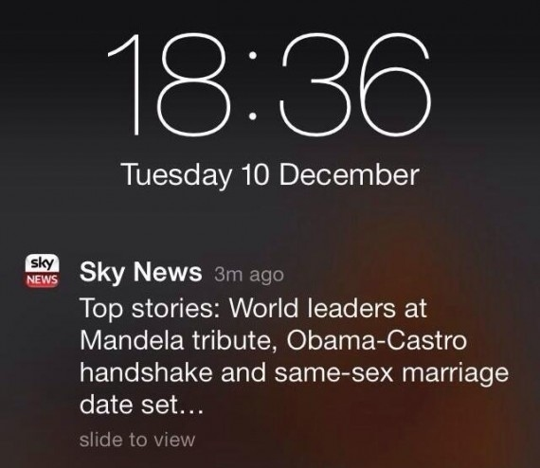
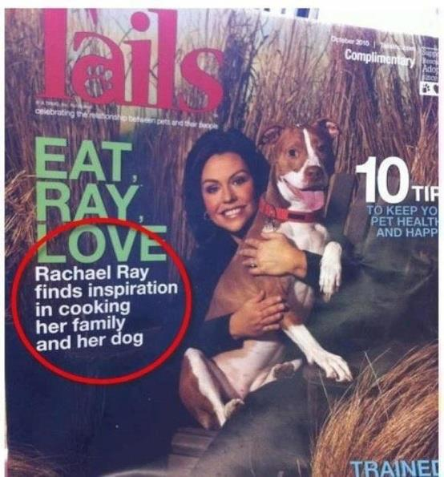
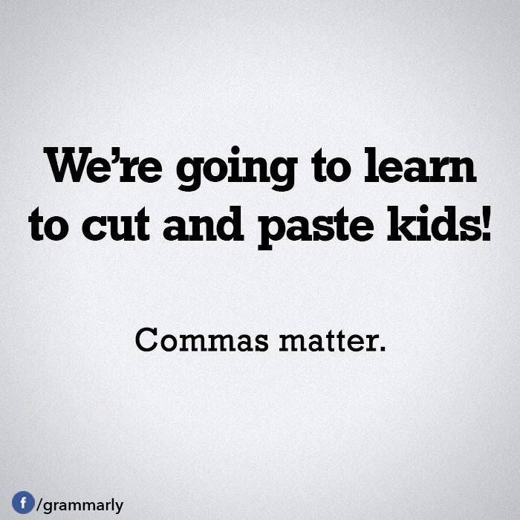
Don’t forget your commas ☺

