Slide 1
Writing CORNER #3
Art History: Manet Essay Assignment

Slide 2
Reminder: This paper is due March 13th (next monday) in class! It should be approximately three pages and use quotations from your textbook

Slide 3
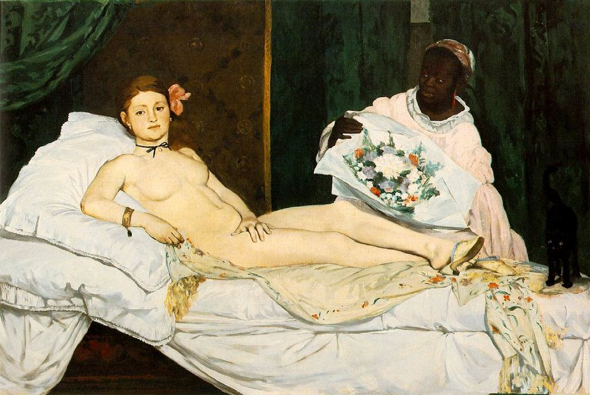
1) Select a piece of artwork!
Olympia

Slide 4
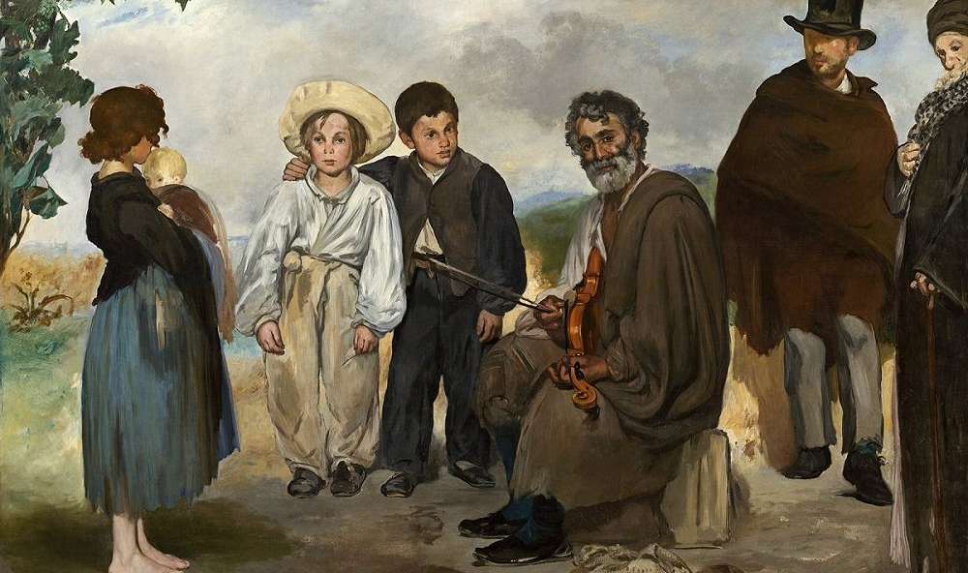
The Old Musician

Slide 5
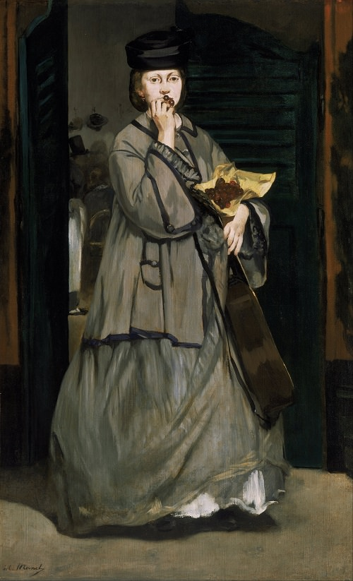
The Street Singer

Slide 6
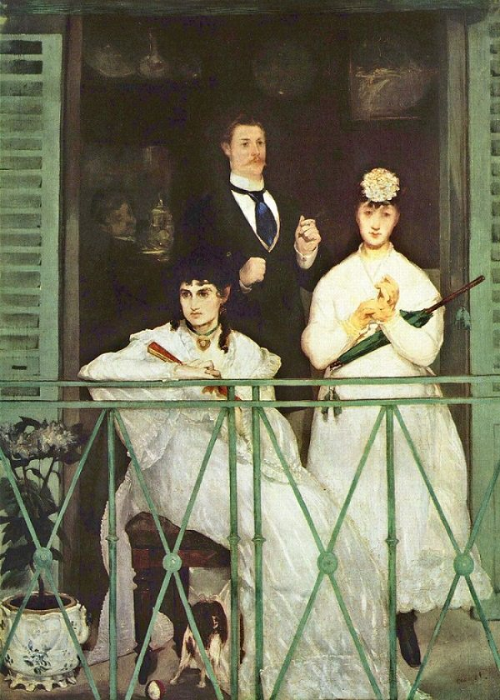
The Balcony

Slide 7
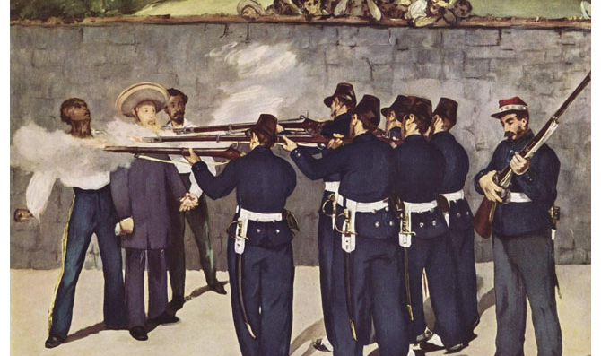
The Execution of Maximilian

Slide 8
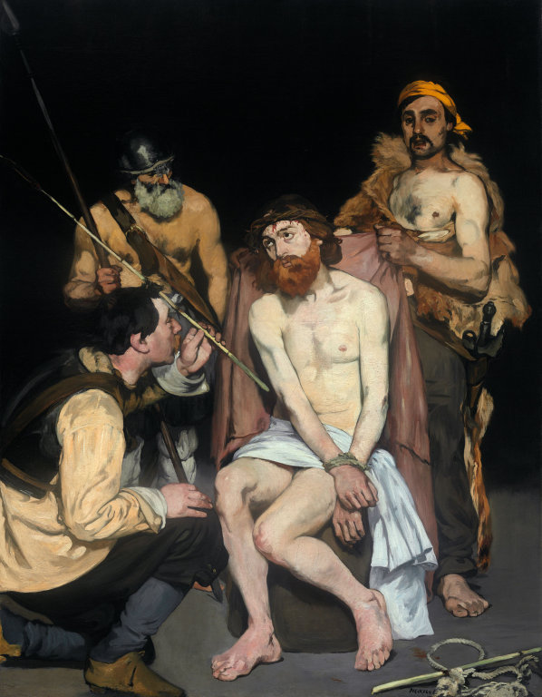
Christ Mocked

Slide 9
2) Begin writing with an Intro Paragraph
A short paragraph
What painting did you pick?
A few sentence summary of why you picked that painting and the most important things you will talk about in your paper. A preview!

Slide 10
3) Body Section 1 (about one page)
Artistic elements of the painting
Visual evidence:
- Colors - Shapes - Figures - Spacing - Etc.
interpret the meaning of the artwork:
What do you see in this piece and what does it mean?

Slide 11
4) Body Section 2 (about one page)
Historical Context
Discuss Monet’s life and the time that the painting was made at. Use your textbook to find information about the artist and the time period.
How are these things reflected in the meaning of the artwork?
Use key terms: modernism, tradition, Old Masters, Frenchness, Impressionism, etc. in your explanation

Slide 12
5) Body Section 3 (about one page)
Why should we study this piece still in 2017?
Connections that you make personally or with today’s society
What does this artwork teach us? What is the message that we can take away from this painting?

Slide 13
6) Finish your essay with a Conclusion
A few sentences summarizing what you talked about
Remind the reader of the most important things you said in the paper!

Slide 14
Citations (Author’s last name, year, page #)
If you quote another source:
At the time that Olympia was completed, “…” (Freid,1996,p.98).
If you summarize an idea from the text book:
No quotation marks necessary. Rewrite the idea in your own words, but give the source that inspired you credit.

