Slide 1
Odyssey Course:
Art History
Gauguin’s Skirt
March 13, 2017

Slide 2
Announcements:
Please submit Paper #1 today, March 13!
We are currently reading Stephen Eisenman’s text Gauguin’s Skirt; you should have up to Chapter One read by now.
Paper #2, on Gauguin’s Skirt, will be due Monday, April 3.
During break, please read Chapter Two of Gauguin’s Skirt and begin working on Paper #2.

Slide 3
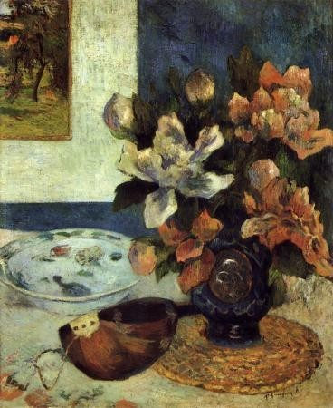
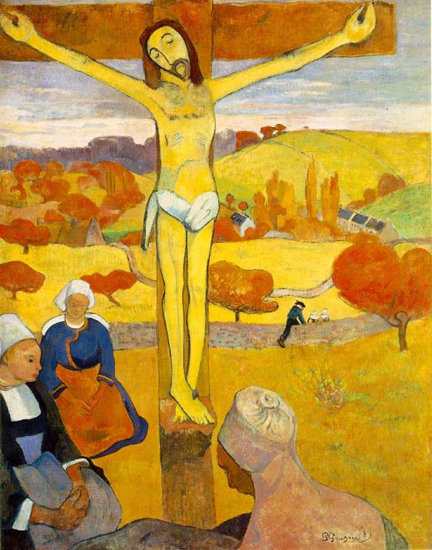
Exoticism to Primitivism
Still Life with Vase of Japanese Peonies & Mandolin, 1885
Yellow Christ, 1889

Slide 4
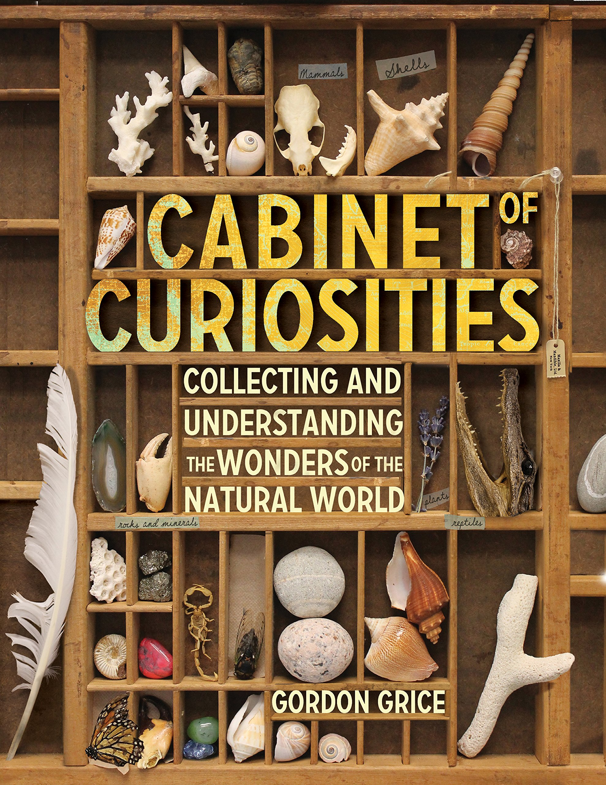
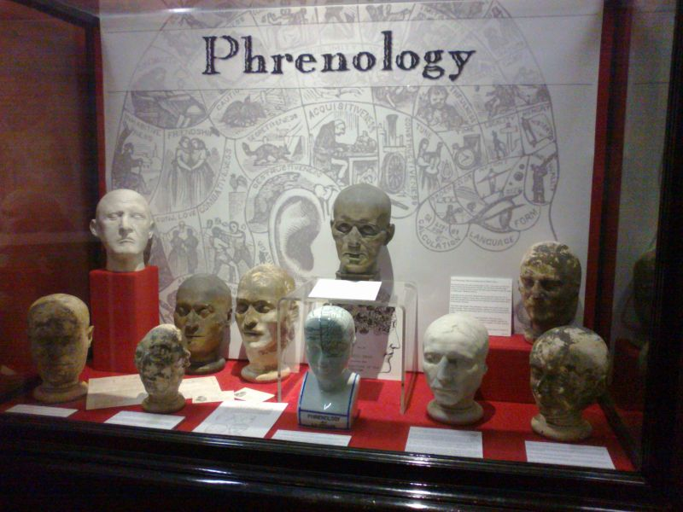
Relationship to the Other
Genuine Curiosity leads to Studying Things
Studying People Introduces a Power Dynamics and Moral Concerns

Slide 5
On Race
“There is no definition of race without racism before it.” Ta-Nehisi Coates, author of Between the World and Me, MacArthur Genius Grant winner, The Atlantic correspondent

Slide 6
Gauguin’s letter to his wife, Metti (1890)
“May the day come—and perhaps soon—when I can flee to the woods on a South Sea island, and live there in ecstasy, in peace and for art. With a new family, far from this European struggle for money. There, in Tahiti, in the silence of the lovely tropical night, I can listen to the sweet murmuring music of my heart, beating in amorous harmony with the mysterious beings of my environment. Free at last, with no money troubles, and able to love, to sing and to die.” (Eisenman, 1997, p. 53)
Supports Eisenman’s claim, that Gauguin sought a primitive utopia, where money was unnecessary, and mutual aid was the basis for a free and independent life (Eisenman, 1997, p. 56).

Slide 7
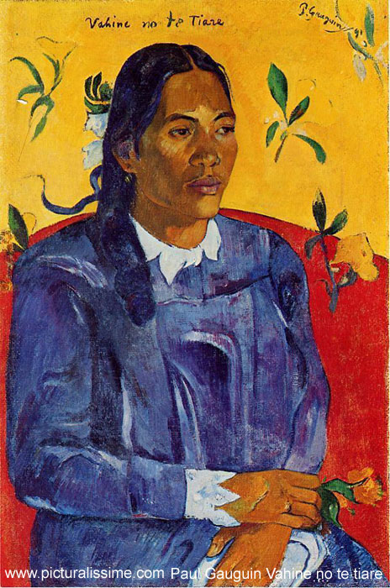
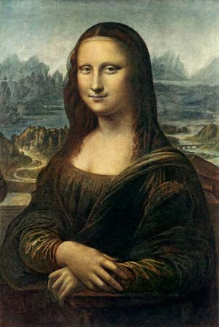
Noble Representation
Woman with Flowers, 1891-92
Leonardo da Vinci, Mona Lisa, 1503-1517

Slide 8
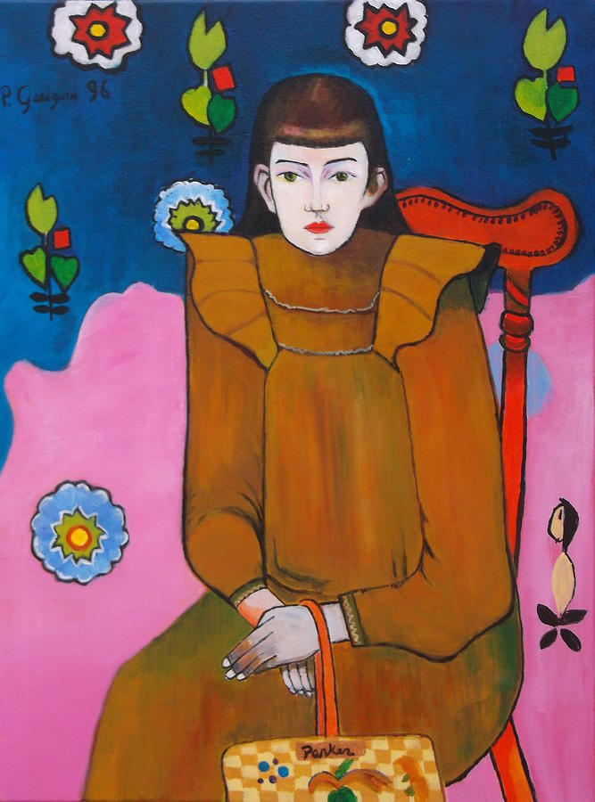
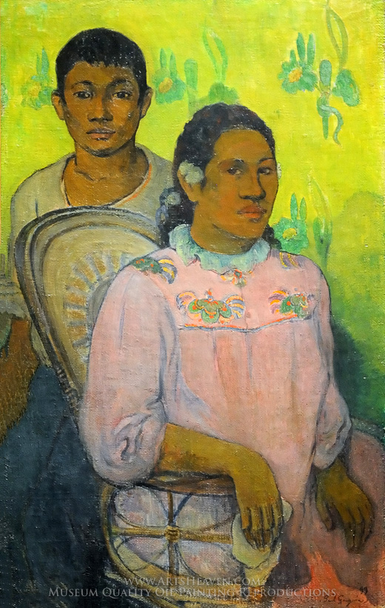
Portraits of Locals
Portrait of Jeanne Goupil, 1896
Tahitian Woman and Boy, 1899

Slide 9
Gauguin’s liminal stance
“In Tahiti an the Marquesas, Gauguin had no fixed sexual identity, but by virtue of that lack, he was able to compare the Polynesian mahu with his/her European counterparts, the invertis and the androgynes. Gauguin occupied no secure social, cultural or religious position, but by virtue of that very placelessness was able to observe some of the complex personalities, sociabilities and sexualities of indigenous Tahitians in an age of imperialism.” (Gauguin, 1997, p. 147)

Slide 10
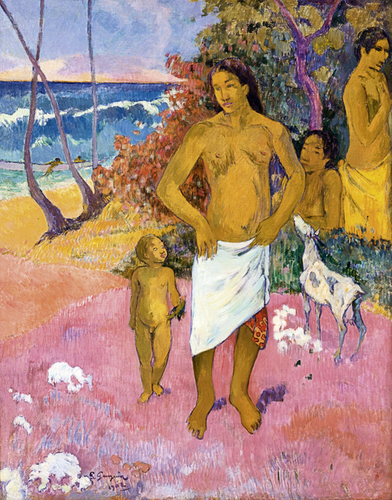
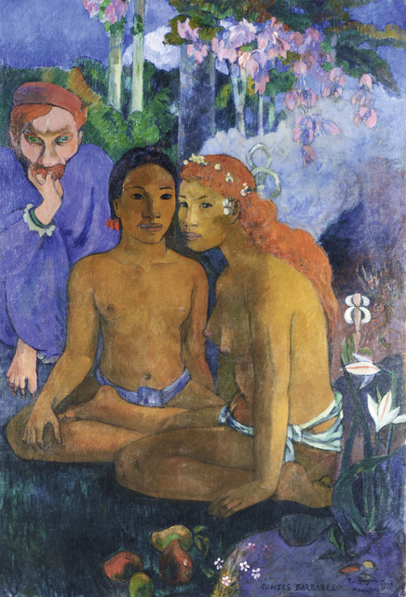
Gender Liminality
Bathers, 1902
Primitive Tales, 1902

Slide 11
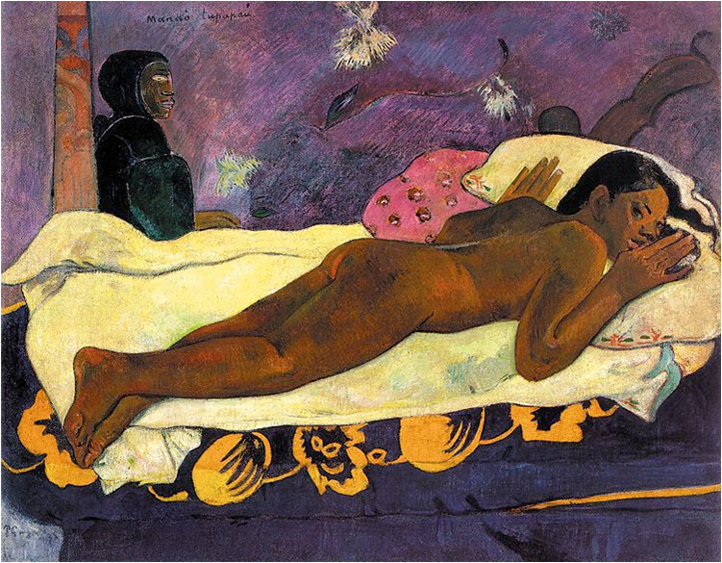
The Spirit of the Dead Watching, 1892

Slide 12
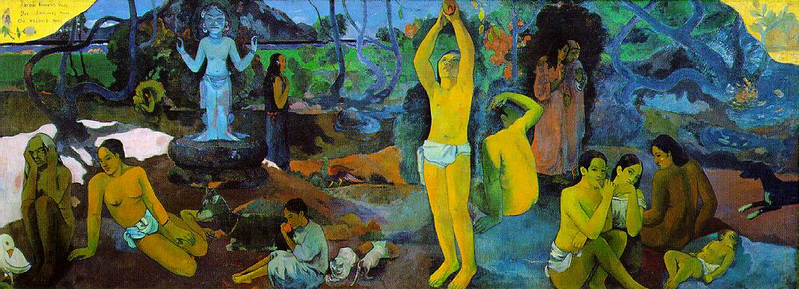
Where do we come from? What are we? Where are we going? 1897-98

Slide 13
Primitivism
Operates on the assumption of deficiency in qualities when compared to Western traditions.
Also assumes innocence, purity, and static history and cultures of non-Western peoples.
Cultural primitivism assumes no change over time has taken place, no evolution has occurred, and no further developments are expected.
Artistic primitivism assumes Western vision can benefit from engaging with cruder forms of art and nature, and that the Western psychology can be altered upon connecting with non-Western art.

Slide 14
Chronological Primitivism
The assumption is that there is a best or most excellent time or best state of the world in general for humans to exist, such as a Golden Age (according to anthropologists Lovejoy and Boas).
Primitivists believe that the current state of the world can only be judged as the best state when there has been a return to the prior “Golden Age.”
This is a romantic, utopian (idealistic) belief about civilization and progress that tends toward mythology rather than historical fact.

Slide 15
“Savage” Primitivism
The myth of the “Noble Savage” is based in a romantic idea that the native is inherently good, happy, and better than the colonizer because he has been uncorrupted by civilization.
The assumption can be that there is more sincerity found in primitive cultures.
Or, the assumption is that primitives are something to fear: this signals a change in the perception from noble to dangerous savage.

Slide 16
Cultural Primitivism
Stems from cultural discontent with Western civilization, materialism, technological advancements, and societal norms.
An overly romanticized response to childhood, underdeveloped peoples and their cultures, rural ways of life, earlier civilizations, and non-Western peoples.
Lovejoy and Boas (1935) called it “the discontent of the civilized with civilization, or with some conspicuous and characteristic feature of it. It is the belief of men in a highly evolved and complex cultural condition that a life far simpler and less sophisticated in some or all respects is a more desirable life.” p. 20 Rhodes, Primitivism and Modern Art

Slide 17
Artistic Primitivism
Assumes a pre-rational or childlike psychology in the creation of artworks.
Informed by artists’ experiences with non-Western, folk, and “craft-like” art forms.
Deals with “Western responses to tribal cultures and specifically with artistic insights gained through the experience of primitive art.
However, this position already unwittingly contains a significant assumption- that the primitive is a recognizable category containing a large number of extra-European cultural groups united by a shared organization and/or psychological state.
This argument does not, however, bear close scrutiny.” p. 17 Rhodes, Primitivism and Modern Art

Slide 18
Gauguin’s Primitivism
A combination of the different types.
Curious about indigenous land and people.
Open to inspiration from the “the original source” and “the childhood of mankind.”
Eager to produce new expressive art works, based on his inspiration.
The critical aspect of it is that Gauguin encountered people with creative minds who held nuanced ideas about sex, nature, property, and family that challenged European modernity.

